Slide 1
Refresher
Create a dictionary that maps the following acronymns to their definitions:
BLS
DOL
USA
Create a function that accepts an acronym as an input and returns the definition of this acronym as the output

Slide 2
Task 1
Download an MSHA file at https://github.com/ameasure/autocoding-class
Use Python to:
Add a column to this file that contains code 530 if the corresponding narratives indicates a foot injury, and nothing otherwise
Split the coded file into separate Excel files, one for each state (containing only that state’s codes)

Slide 3
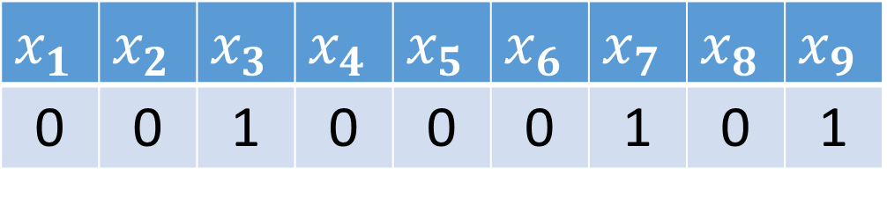
Feature Representation
“broke his foot”
$$x_{1}$$ | $$x_{2}$$ | $$x_{3}$$ | $$x_{4}$$ | $$x_{5}$$ | $$x_{6}$$ | $$x_{7}$$ | $$x_{8}$$ | $$x_{9}$$
0 | 0 | 1 | 0 | 0 | 0 | 1 | 0 | 1

Slide 4
Logistic Function

Slide 5
Multinomial Logistic Regression

Slide 6
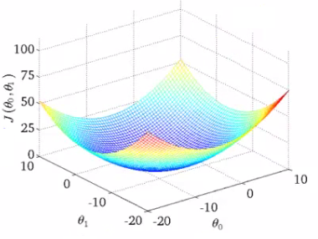


Gradient Descent
Cost(w)
$$w_{A1}$$
$$w_{A2}$$

Slide 7
Cost Function Revised

